Slide 1

MUNICIPAL ENERGY MANAGER PROGRAM

Slide 2
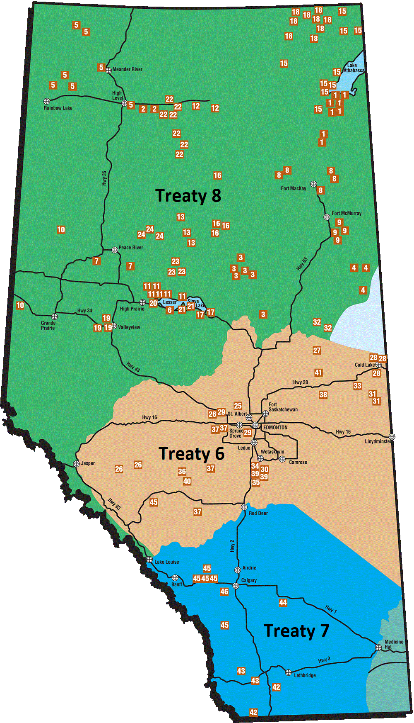
ACKNOWLEDGEMENT
We would like to respectfully acknowledge that this presentation is being presented in Treaty 6 territory.
We acknowledge all the many First Nations, Métis, and Inuit whose footsteps have marked these lands for centuries, and whose presence continues to enrich our vibrant communities.

Slide 3



FUNDERS AND PARTNERS
The Municipal Climate Change Action Centre provides funding, technical assistance, and education to support Alberta municipalities in addressing climate change.
The Municipal Climate Change Action Centre is a partnership between the Government of Alberta, the Alberta Urban Municipalities Association, and Rural Municipalities of Alberta.

Slide 4
AGENDA
WHY MEM?
ENERGY MANAGER DUTIES?
ELIGIBILITY AND COLLABORATION
MEM SUPPORT
FUNDING
PARTICIPATION TIMELINE
QUESTION PERIOD

Slide 5
WHY MEM?

Slide 6
WHY MEM?
80% of a municipal energy manager’s salary up to $80K per year and a maximum of two years
Neighbouring municipalities can partner and share the MEM across their region
Develop an energy management plan to save energy and reduce GHGs
MEMs will receive training and support from our technical advisor, CLEAResult

Slide 7
ENERGY MANAGER RESPONSIBILITIES
The Municipal Energy Manager will help your municipality to:
Develop an Energy Management Plan (EMP)
Track energy consumption
Identify energy-saving, cost-saving opportunities, lead projects and apply for funding from MCCAC programs
Notes:
Discuss what they will get out of it.
Energy management assessment
Work plan
Building bench marking
GHG targets
Identifying energy efficiency opportunities
Presentations to council and staff
Energy audits
Completing GHG reducing projects
Progress reports

Slide 8
WHO IS ELIGIBLE?

Slide 9
WHO IS ELIGIBLE?
Are within the Province of Alberta
Are defined as a municipality as per Section 1(s) of the Municipal Government Act
Have a population size below 150,000 residents
Municipalities can partner and share a MEM across a region with other municipalities.
Notes:
MEM is designed for municipalities that lack internal resources to engage in energy management work and thus, the municipalities above 150,000 residents are ineligible as they have large teams dedicated to energy management.
Also ineligible are municipalities who were awarded funding for climate change mitigation staff grants from the Municipalities for Climate Innovation Program (MCIP) and the Federation of Canadian Municipalities (FCM). This funding already covers the salary of a position inside the municipality to complete similar work as our MEM program. Municipalities who received climate change ADAPTION staff grants through MCIP and FCM are eligible for MEM as there is limited overlap in the scope and deliverables of these two positions.

Slide 10
EXAMPLE

Slide 11
Municipalities can partner and share a MEM with other municipalities
Population Statistics:
County = 6,000
Town 1 = 5,000
Village = 50
The County, Town and the Village all share one Municipal Energy Manager. The County is the primary partner, who manages the MEM, but they work within the collaborating region.
V
County
Town
Notes:
Go through example
In this example, the county is the lead participant who will sign the funding agreement, manage the MEM, and receive the incentive payments on behalf of the partnership. MCCAC will not be involved in determining the specifics of the partnership, duties of each member, or distribution of funds within the partnership, if any. It is up to the collaborating municipalities to select the lead participant.
MCCAC will evaluate on a case by case basis. The ideal collaboration size is approximately 2-4 municipalities, although MCCAC may assess each collaboration individually.

Slide 12
SUPPORT

Slide 13
SUPPORT
MEM Term | MCCAC
Technical advice | Sample Job Description
Municipal Training | Skills and Behavior Checklist
Coaching for MEM | Other supporting documents
Notes:
MCCAC will work with CLEAResult Canada Inc. to deliver technical advice, training, and coaching support to each hired MEM in the program. CLEAResult’s team has significant experience implementing energy management programs across North America and will be a great asset to both the MEM program and each hired MEM
Supplementary documents such as sample job descriptions, competency checklists and other items will be made available to assist with the hiring process.

Slide 14
FUNDING

Slide 15
FUNDING
CLEAResult | Funding Amount
Year One | 80% of salary to a maximum of $80,000 per year
Year Two | 80% of salary to a maximum of $80,000 per year (optional and contingent on meeting minimum year one deliverables)
Notes:
- Payment schedule
40% of MEM salary upon executed funding agreement and notice of employment start date
40% upon receiving and approving Q2 progress report
Year 2
Upon approval of year 1 Q3 progress report, and the request for year 2 funding, will fund 40% to be paid after the mem’s employment anniversary and upon receiving an executed funding agreement.
40% upon receiving and approving Q2 progress report

Slide 16
PARTICIPATION TIMELINE
1
2
3
4
5
6
Review guidebook and resources
Submit Expression of Interest
Submit application
Sign funding agreement
Hire a Municipal Energy Manager
Receive funding, and save energy and money

Slide 17
APPLYING

Slide 18
APPLICATION
Describe your current energy management capabilities, and the need for energy management support
MCCAC will approve program participation on a case-by-case basis
Describe intended activities and projects
Intended salary and salary band, including brief rationale
Rough estimation of funding the municipality is willing to allocate to energy efficiency and renewable energy projects
Notes:
Network of Canadian municipalities committed to taking action on climate change.
Members benefit from our support to reduce GHGs.
Free training, resources and advice with Regional Climate Advisors.
The Action Centre is now home to Alberta’s Regional Climate Advisor. Reach out for local expertise, advice and training.

Slide 19
OTHER FUNDING AND SERVICES

Slide 20
OTHER FUNDING PROGRAMS
ELECTRIC VEHICLES FOR MUNICIPALITIES PROGRAM
RECREATION ENERGY CONSERVATION PROGRAM
ALBERTA MUNICIPAL SOLAR PROGRAM
SOLAR FOR SCHOOLS PROGRAM
PARTNERS FOR CLIMATE PROTECTION PROGRAM
Notes:
Network of Canadian municipalities committed to taking action on climate change.
Members benefit from our support to reduce GHGs.
Free training, resources and advice with Regional Climate Advisors.
The Action Centre is now home to Alberta’s Regional Climate Advisor. Reach out for local expertise, advice and training.

Slide 21
ADVISORY SERVICES
PARTNERS FOR CLIMATE PROTECTION PROGRAM
Network of Canadian municipalities committed to taking action on climate change.
Members benefit from our support to reduce GHGs.
Free training, resources and advice with Regional Climate Advisors.
The Action Centre is now home to Alberta’s Regional Climate Advisor. Reach out for local expertise, advice and training.

Slide 22




contact@mccac.ca
mccac.ca
THANK YOU

